Slide 1
LASU INNOVATION TO SOLVING COVID-19 PANDEMIC
Dr. Nurudeen A. Raji
Mechanical Engineering Department
Lagos State University, Nigeria
11th VIRTUAL PUBLIC LECTURE

Slide 2
COVID-19 PANDEMIC
OUTLINE:
Background
COVID-19 Research Categories
LASU Innovative Response to COVID-19 Pandemic
Automatic Hand Washing Machine
Pedal Operated Hand Washing Machine
Operation
Opportunities
Conclusion

Slide 3
BACKGROUND
The outbreak and spread of COVID-19 disease has constituted most of the recent challenges to world economy, health and social development.
However the problems associated with the spread had encouraged creativity and innovation worldwide towards limiting the outbreak and protecting life.
Most developing countries like Nigeria had always depended on foreign supplies of medical tools, equipments, protective gears, and medicine. The lockdown imposed on border movement of equipment and persons had necessitated the need for developing countries to look inward for solution towards fighting the pandemic.

Slide 4
COVID-19 RESEARCH CATEGORIES
12 categories of the COVID-19 Pandemic response had been identified

Slide 5
LASU INNOVATIVE RESPONSE TO COVID-19 PANDEMIC
Some of the innovations coming out of Lagos State University include;
Customized hand sanitizer and face mask
3-service points automatic hand washing station
Single-service point automatic hand washing unit
Single service point pedal operated hand washing unit
These innovations are centered on the prevention category of the COVID-19 Pandemic response.
The customized hand sanitizers and face masks were produced by the Faculty of Science to further combat the spread the virus

Slide 6
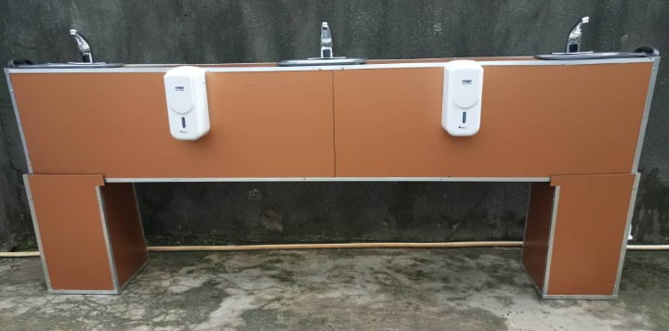
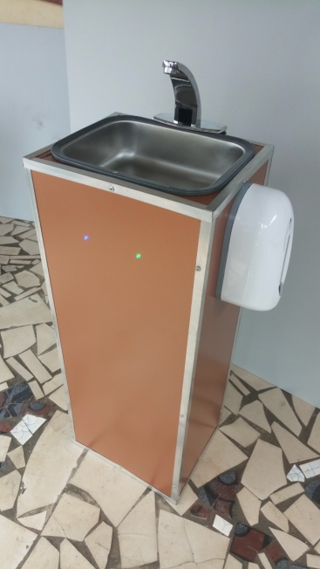
AUTOMATIC HAND WASHING STATION
DESCRIPTION
Framework
Infrared sensor water taps
Liquid soap dispenser
Aluminum composite claddings
Clean and waste water pipe –network
Solar power system

Slide 7
UNIQUE DESIGN FEATURES
The unique features of the machine include;
Water and shock resistance cladding (To improve the durability and reliability of such machine)
Solar power system with rechargeable batteries that can sustain the system for a year with continuous operation and fully charged power supply for 5-days non-stop in the absence of solar energy.
Durability
Flexible installation and operating procedure
LED indicators

Slide 8
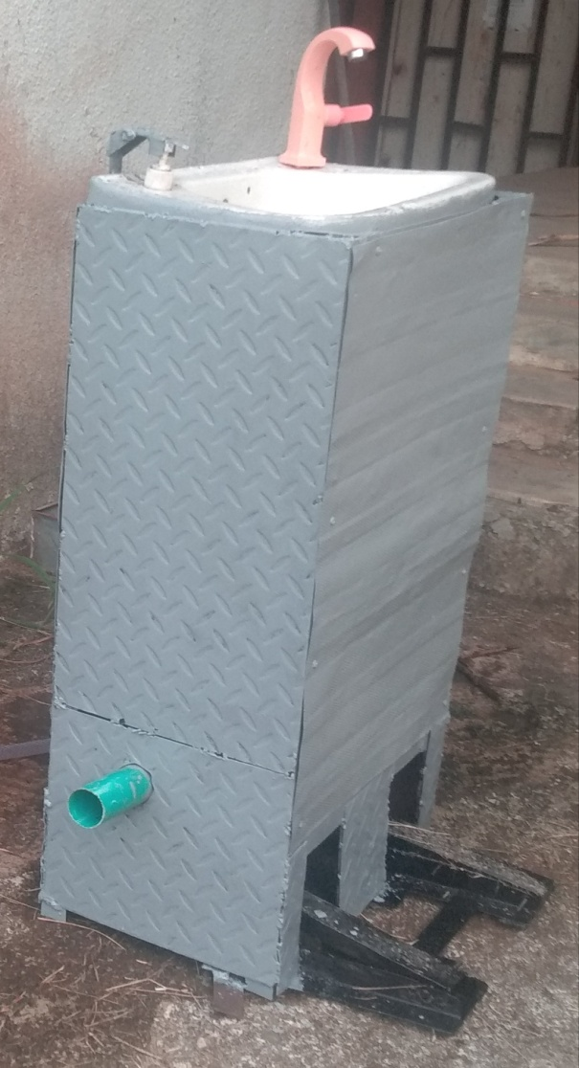
PEDAL OPERATED HAND WASHING MACHINE
The single unit pedal operated hand washing machine is reliable, efficient and cheap.
Framework
Soap and water dispensing pedals
Water dispensing tap
Soap dispenser
Clean and waste water lines

Slide 9
OPERATION : 3 Service points AHWS

Slide 10
OPERATION : Single Service point AHWS

Slide 11
OPERATION : Pedal Operated HWM

Slide 12
LASU INNOVATIVE RESPONSE TO COVID-19 PANDEMIC (Cont.)
The Faculty of Engineering COVID 19 research team is currently working on;
New ventilator termed COVID EMMERGENCY VENTILATOR,
Social distancing device, and
Disinfectant channel

Slide 13
OPPORTUNITIES
There is no doubt that the COVID-19 pandemic has proven to be a serious challenge. However, within this challenge, there are opportunities for LASU to excel as a University.
LASU could build a world class recognition if the researchers are encouraged to make use of the opportunities presented by the COVID-19 crises.
There is the need to join other researchers to look inward in order to explore the natural, technological knowledge and human resources available to fight the pandemic.
Partnership with Professional bodies
LASU should see Covid-19 as an intensive test of its agility.
It would be impossible to pull off any alternative teaching plan without concerted action by faculty and support staff.
Furthermore, given a limited window of time, the success rate is also contingent on whether there has been adequate openness to new technology and investment in infrastructure.

Slide 14
CONCLUSION
Lagos State University need to rise to future challenges with innovation mindset in order to be classified as one of the world class rated university. It is important to start bracing for unpredictable challenges as a University of World class nature. It is therefore imperative to strategize towards transforming our university into an institution driven by innovation with a supposed greater level of excellence.
THANK YOU

